Slide 1

Chapter 6: Macroeconomic Measurements Part I: Prices and Unemployment
© 2014 Cengage Learning. All Rights Reserved. May not be copied, scanned, or duplicated, in whole or in part, except for use as permitted in a license distributed with certain product , service, or otherwise on password-protected website for classroom use

Slide 2

In This Lecture…..
Measuring Prices
Unemployment and Employment
To select a topic, click on its link above
© 2014 Cengage Learning. All Rights Reserved. May not be copied, scanned, or duplicated, in whole or in part, except for use as permitted in a license distributed with certain product , service, or otherwise on password-protected website for classroom use

Slide 3

Macroeconomic Problems
High inflation rate
High unemployment rate
High interest rates
Low economic growth or stagnation
Click to return to “In this Lesson”
© 2014 Cengage Learning. All Rights Reserved. May not be copied, scanned, or duplicated, in whole or in part, except for use as permitted in a license distributed with certain product , service, or otherwise on password-protected website for classroom use

Slide 4
Macroeconomic Measures - Prices
Price Level - A weighted average of the prices of all good and services.
Price Index - A measure of the price level.
Consumer Price Index (CPI) - A widely cited index number for the price level; the weighted average of prices of a specific set of goods and services purchased by a typical household.
Click to return to “In this Lesson”
© 2014 Cengage Learning. All Rights Reserved. May not be copied, scanned, or duplicated, in whole or in part, except for use as permitted in a license distributed with certain product , service, or otherwise on password-protected website for classroom use

Slide 5

Macroeconomic Measures - Prices
Base Year - The year chosen as a point of reference or basis of comparison for prices in other years; a benchmark year.
Click to return to “In this Lesson”
© 2014 Cengage Learning. All Rights Reserved. May not be copied, scanned, or duplicated, in whole or in part, except for use as permitted in a license distributed with certain product , service, or otherwise on password-protected website for classroom use

Slide 6
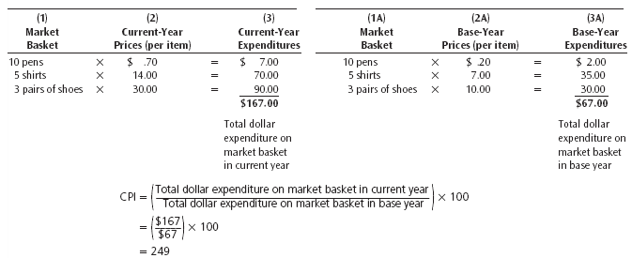
Computing the Consumer Price Index
Click to return to “In this Lesson”
© 2014 Cengage Learning. All Rights Reserved. May not be copied, scanned, or duplicated, in whole or in part, except for use as permitted in a license distributed with certain product , service, or otherwise on password-protected website for classroom use

Slide 7
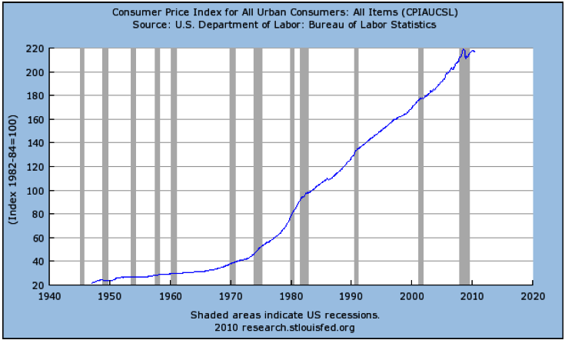
Consumer Price Index 1940-2010
Click to return to “In this Lesson”
© 2014 Cengage Learning. All Rights Reserved. May not be copied, scanned, or duplicated, in whole or in part, except for use as permitted in a license distributed with certain product , service, or otherwise on password-protected website for classroom use

Slide 8
Changes in Prices
In 2005 the CPI was 195.3; in 2006 the index was 201.6. What was the percentage change in prices from 2005-2006?
Click below for answer.
3.23 %
Click to return to “In this Lesson”
© 2014 Cengage Learning. All Rights Reserved. May not be copied, scanned, or duplicated, in whole or in part, except for use as permitted in a license distributed with certain product , service, or otherwise on password-protected website for classroom use

Slide 9
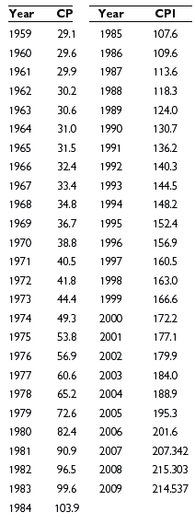
CPI, 1959-2009
Click to return to “In this Lesson”
© 2014 Cengage Learning. All Rights Reserved. May not be copied, scanned, or duplicated, in whole or in part, except for use as permitted in a license distributed with certain product , service, or otherwise on password-protected website for classroom use

Slide 10

Inflation
Inflation is an increase in the price level and is usually measured on an annual basis. The inflation rate is the positive percentage change in the price level on an annual basis.
Click to return to “In this Lesson”
© 2014 Cengage Learning. All Rights Reserved. May not be copied, scanned, or duplicated, in whole or in part, except for use as permitted in a license distributed with certain product , service, or otherwise on password-protected website for classroom use

Slide 11
Inflation
When you know the inflation rate, you can find out whether your income is
(1) keeping up with,
(2) not keeping up with, or
(3) more than keeping up with inflation.
How you are doing depends on whether your income is rising by
the same percentage as,
(2) a smaller percentage than, or
(3) a greater percentage than the inflation rate, respectively.
Click to return to “In this Lesson”
© 2014 Cengage Learning. All Rights Reserved. May not be copied, scanned, or duplicated, in whole or in part, except for use as permitted in a license distributed with certain product , service, or otherwise on password-protected website for classroom use

Slide 12

Inflation
When you make this computation and comparison, you are determining your real income for different years.
Real income is a person’s nominal income (or current dollar amount of income) adjusted for any change in prices. Real income is computed as follows:
Click to return to “In this Lesson”
© 2014 Cengage Learning. All Rights Reserved. May not be copied, scanned, or duplicated, in whole or in part, except for use as permitted in a license distributed with certain product , service, or otherwise on password-protected website for classroom use

Slide 13

Macroeconomic Measures - Prices
Gasoline cost $1.15 per gallon in 1980. At today’s prices are we better off?
Click below to check.
Click to return to “In this Lesson”
© 2014 Cengage Learning. All Rights Reserved. May not be copied, scanned, or duplicated, in whole or in part, except for use as permitted in a license distributed with certain product , service, or otherwise on password-protected website for classroom use

Slide 14
GDP Implicit Price Deflator vs. Consumer Price Index
GDP Implicit Price Deflator is based upon all goods and services produced in an economy.
CPI is based upon a representative group of goods and services purchased by a typical household
Click to return to “In this Lesson”
© 2014 Cengage Learning. All Rights Reserved. May not be copied, scanned, or duplicated, in whole or in part, except for use as permitted in a license distributed with certain product , service, or otherwise on password-protected website for classroom use

Slide 15
Converting Dollars from One Year to Another
Now suppose someone tells you that a $10,000 dollar salary in 1960 is the same as a $75,992 salary today. Would you then be better able to say whether the 1960 $10,000 salary was good or not so good? Of course you would because you understand what it means to earn $75,992 today. Economists convert a past salary into today’s salary by using this formula:
$$Salary in today^{′}s dollars={Salary}_{Earlier year} x (\frac{{CPI}_{Current year}}{{CPI}_{earlier year}})$$
$$Salary in 2011 dollars=\$10,000 x \left(\frac{224.939}{29.6}\right)=\$75,992$$
Click to return to “In this Lesson”
© 2014 Cengage Learning. All Rights Reserved. May not be copied, scanned, or duplicated, in whole or in part, except for use as permitted in a license distributed with certain product , service, or otherwise on password-protected website for classroom use

Slide 16
Self Test
Explain how the CPI is calculated.
The CPI is calculated as follows:
(1) define a market basket,
(2) determine how much it would cost to purchase the market basket in the current year and in the base year
(3) divide the dollar cost of purchasing the market basket in the current year by the dollar cost of purchasing the market basket in the base year, and
(4) multiply the quotient by 100.
Click to return to “In this Lesson”
© 2014 Cengage Learning. All Rights Reserved. May not be copied, scanned, or duplicated, in whole or in part, except for use as permitted in a license distributed with certain product , service, or otherwise on password-protected website for classroom use

Slide 17
Self-Test
What is a base year?
It is a year that is used for comparison purposes with other years.
Click to return to “In this Lesson”
© 2014 Cengage Learning. All Rights Reserved. May not be copied, scanned, or duplicated, in whole or in part, except for use as permitted in a license distributed with certain product , service, or otherwise on password-protected website for classroom use

Slide 18
Self-Test
In year 1, your annual income is $45,000 and the CPI is 143.6; in year 2, your annual income is $51,232 and the CPI is 150.7. Has your real income risen, fallen, or remained constant? Explain your answer.
Annual (nominal) income has risen by 13.85 percent while prices have risen by 4.94 percent. We conclude that because (nominal) income has risen more than prices, real income has increased. Alternatively, you can look at it this way: Real income in year 1 is $31,337, and real income in year 2 is $33,996.
Click to return to “In this Lesson”
© 2014 Cengage Learning. All Rights Reserved. May not be copied, scanned, or duplicated, in whole or in part, except for use as permitted in a license distributed with certain product , service, or otherwise on password-protected website for classroom use

Slide 19
Unemployment
The total population of the United States can be divided into two broad groups.
One group consists of persons who are (1) under 16 years of age, (2) in the armed forces, or (3) institutionalized (in a prison, mental institution, or home for the aged).
The second group, which consists of all others in the total population, is called the civilian non-institutional population.
Click to return to “In this Lesson”
© 2014 Cengage Learning. All Rights Reserved. May not be copied, scanned, or duplicated, in whole or in part, except for use as permitted in a license distributed with certain product , service, or otherwise on password-protected website for classroom use

Slide 20
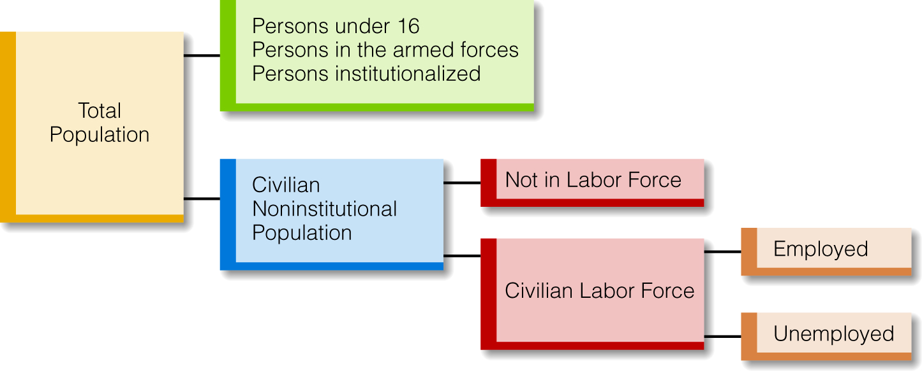
Who Are the Unemployed?
Click to return to “In this Lesson”
© 2014 Cengage Learning. All Rights Reserved. May not be copied, scanned, or duplicated, in whole or in part, except for use as permitted in a license distributed with certain product , service, or otherwise on password-protected website for classroom use

Slide 21
Who Are the Employed?
According to the Bureau of Labor Statistics (BLS), employed persons consist of:
• All persons who did any work for pay or profit during the survey reference week.
• All persons who did at least 15 hours of unpaid work in a family-operated enterprise.
• All persons who were temporarily absent from their regular jobs because of illness, vacation, bad weather, industrial dispute, or various personal reasons.
Click to return to “In this Lesson”
© 2014 Cengage Learning. All Rights Reserved. May not be copied, scanned, or duplicated, in whole or in part, except for use as permitted in a license distributed with certain product , service, or otherwise on password-protected website for classroom use

Slide 22
Who Are the Unemployed?
According to the BLS, unemployed persons consist of:
• All persons who did not have jobs, who made specific active efforts to find a job during the prior four weeks, and who were available for work.
• All persons who were not working and who were waiting to be called back to a job from which they had been temporarily laid off.
Click to return to “In this Lesson”
© 2014 Cengage Learning. All Rights Reserved. May not be copied, scanned, or duplicated, in whole or in part, except for use as permitted in a license distributed with certain product , service, or otherwise on password-protected website for classroom use

Slide 23
Unemployment
Unemployment Rate-The percentage of the civilian force that is unemployed:
$$Unemployment Rate \left(U\right)= \frac{Number of Unemployed Persons}{Civilian Labor Force}$$
Click to return to “In this Lesson”
© 2014 Cengage Learning. All Rights Reserved. May not be copied, scanned, or duplicated, in whole or in part, except for use as permitted in a license distributed with certain product , service, or otherwise on password-protected website for classroom use

Slide 24
Unemployment
Employment Rate -The percentage of the civilian noninstitutional population that is employed:
$$Employment Rate \left(E\right)= \frac{Number of Employed Persons}{Civilian Noninstitutional Population }$$
Click to return to “In this Lesson”
© 2014 Cengage Learning. All Rights Reserved. May not be copied, scanned, or duplicated, in whole or in part, except for use as permitted in a license distributed with certain product , service, or otherwise on password-protected website for classroom use

Slide 25
Labor Force Participation Rate
Labor force participation rate - The percentage of the civilian non-institutional population that is in the civilian labor force:
$$Labor Force Participation Rate (LFPR)= \frac{Civilian Labor Force}{Civilian Noninstitutional Population }$$
Click to return to “In this Lesson”
© 2014 Cengage Learning. All Rights Reserved. May not be copied, scanned, or duplicated, in whole or in part, except for use as permitted in a license distributed with certain product , service, or otherwise on password-protected website for classroom use

Slide 26
Common Misconceptions about Unemployment
Many people mistakenly think that if the unemployment rate is, say, 7%, the employment rate must be 93%. Their assumption is that the unemployment rate plus the employment rate must equal 100 percent. But the unemployment and employment rates do not add up to 100%, because the denominator of the unemployment rate is not the same as the denominator of the employment rate.
The unemployment rate is a percentage of the civilian labor force
The employment rate is a percentage of the civilian noninstitutional population, which is a larger number than the civilian labor force.
Click to return to “In this Lesson”
© 2014 Cengage Learning. All Rights Reserved. May not be copied, scanned, or duplicated, in whole or in part, except for use as permitted in a license distributed with certain product , service, or otherwise on password-protected website for classroom use

Slide 27
Who are the Unemployed?
Job loser. This is a person who was employed in the civilian labor force and was either fired or laid off.
Job leaver. This is a person employed in the civilian labor force who quits his or her job.
Reentrant. This is a person who was previously employed, hasn’t worked for some time, and is currently reentering the labor force.
New entrant. This is a person who has never held a full-time job for two weeks or longer and is now in the civilian labor force looking for a job.
Click to return to “In this Lesson”
© 2014 Cengage Learning. All Rights Reserved. May not be copied, scanned, or duplicated, in whole or in part, except for use as permitted in a license distributed with certain product , service, or otherwise on password-protected website for classroom use

Slide 28

Discouraged Workers
They are former workers who are not actively looking for work and are not waiting to be called back to a job or to report for a job.
Discouraged workers are not counted as unemployed workers
Click to return to “In this Lesson”
© 2014 Cengage Learning. All Rights Reserved. May not be copied, scanned, or duplicated, in whole or in part, except for use as permitted in a license distributed with certain product , service, or otherwise on password-protected website for classroom use

Slide 29
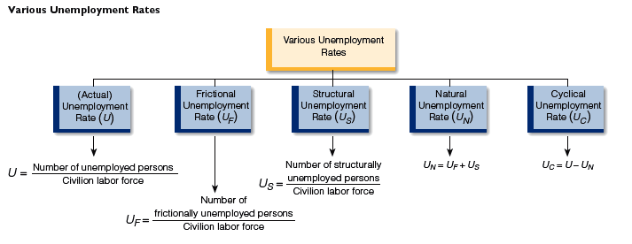
Unemployment Rates
Click to return to “In this Lesson”
© 2014 Cengage Learning. All Rights Reserved. May not be copied, scanned, or duplicated, in whole or in part, except for use as permitted in a license distributed with certain product , service, or otherwise on password-protected website for classroom use

Slide 30

Frictional Unemployment
Unemployment due to the natural “frictions” of the economy, which is caused by changing market conditions and is represented by qualified individuals with transferable skills who change jobs.
Click to return to “In this Lesson”
© 2014 Cengage Learning. All Rights Reserved. May not be copied, scanned, or duplicated, in whole or in part, except for use as permitted in a license distributed with certain product , service, or otherwise on password-protected website for classroom use

Slide 31

Structural Unemployment
Unemployment due to structural changes in the economy that eliminate some jobs and create other jobs for which the unemployed are unqualified.
Click to return to “In this Lesson”
© 2014 Cengage Learning. All Rights Reserved. May not be copied, scanned, or duplicated, in whole or in part, except for use as permitted in a license distributed with certain product , service, or otherwise on password-protected website for classroom use

Slide 32
Natural Unemployment
Unemployment caused by frictional and structural factors in the economy.
Natural unemployment rate = Frictional unemployment rate + Structural unemployment rate.
Click to return to “In this Lesson”
© 2014 Cengage Learning. All Rights Reserved. May not be copied, scanned, or duplicated, in whole or in part, except for use as permitted in a license distributed with certain product , service, or otherwise on password-protected website for classroom use

Slide 33
Full Employment
The condition that exists when the unemployment rate is equal to the natural unemployment rate.
Click to return to “In this Lesson”
© 2014 Cengage Learning. All Rights Reserved. May not be copied, scanned, or duplicated, in whole or in part, except for use as permitted in a license distributed with certain product , service, or otherwise on password-protected website for classroom use

Slide 34
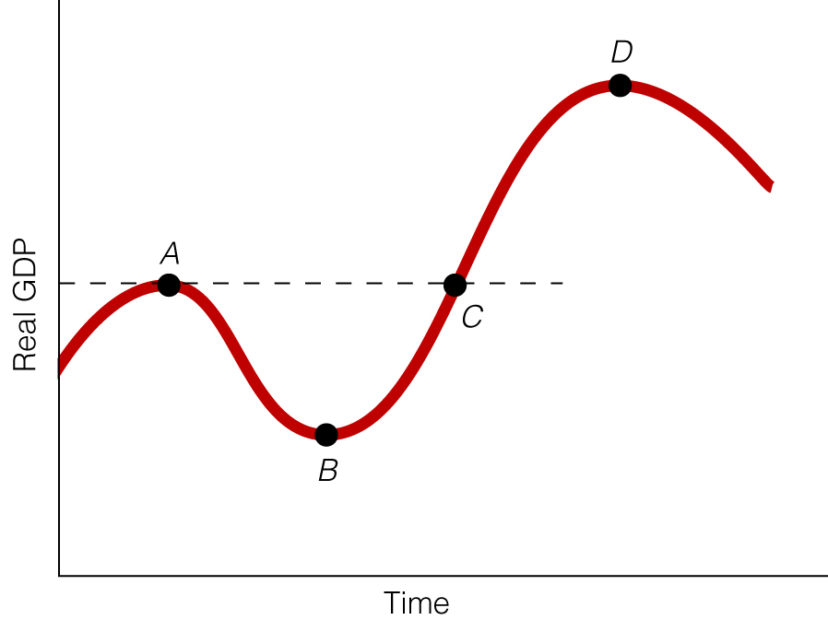
Cyclical Unemployment
Rate
The difference between the unemployment rate and the natural unemployment rate.
Click to return to “In this Lesson”
© 2014 Cengage Learning. All Rights Reserved. May not be copied, scanned, or duplicated, in whole or in part, except for use as permitted in a license distributed with certain product , service, or otherwise on password-protected website for classroom use

Slide 35

Current Information on Prices and Unemployment
Click below for access to information and data from the Bureau of Labor Statistics
Click to return to “In this Lesson”
© 2014 Cengage Learning. All Rights Reserved. May not be copied, scanned, or duplicated, in whole or in part, except for use as permitted in a license distributed with certain product , service, or otherwise on password-protected website for classroom use

Slide 36
Self Test
What is the major difference between a person who is frictionally unemployed and one who is structurally unemployed?
The frictionally unemployed person has readily transferable skills, and the structurally unemployed person does not.
Click to return to “In this Lesson”
© 2014 Cengage Learning. All Rights Reserved. May not be copied, scanned, or duplicated, in whole or in part, except for use as permitted in a license distributed with certain product , service, or otherwise on password-protected website for classroom use

Slide 37
Self Test
If the cyclical unemployment rate is positive, what does this imply?
It implies that the (actual, measured) unemployment rate in the economy is greater than the natural unemployment rate. For example, if the unemployment rate is 8 percent and the natural unemployment rate is 6 percent, the cyclical unemployment rate is 2 percent.
Click to return to “In this Lesson”
© 2014 Cengage Learning. All Rights Reserved. May not be copied, scanned, or duplicated, in whole or in part, except for use as permitted in a license distributed with certain product , service, or otherwise on password-protected website for classroom use

Slide 38

http://www.economagic.com/
This is an easily accessed source of macroeconomic data. Click below to access the website.
Click to return to “In this Lesson”
© 2014 Cengage Learning. All Rights Reserved. May not be copied, scanned, or duplicated, in whole or in part, except for use as permitted in a license distributed with certain product , service, or otherwise on password-protected website for classroom use

Slide 39

Wall Street Journal
The Wall Street Journal is a is a rich source of information which provides real life examples of micro- and macro economic activities. Check today’s issue to see the most current news.
http://www.wsj.com
Click to return to “In this Lesson”
© 2014 Cengage Learning. All Rights Reserved. May not be copied, scanned, or duplicated, in whole or in part, except for use as permitted in a license distributed with certain product , service, or otherwise on password-protected website for classroom use

